Slide 1

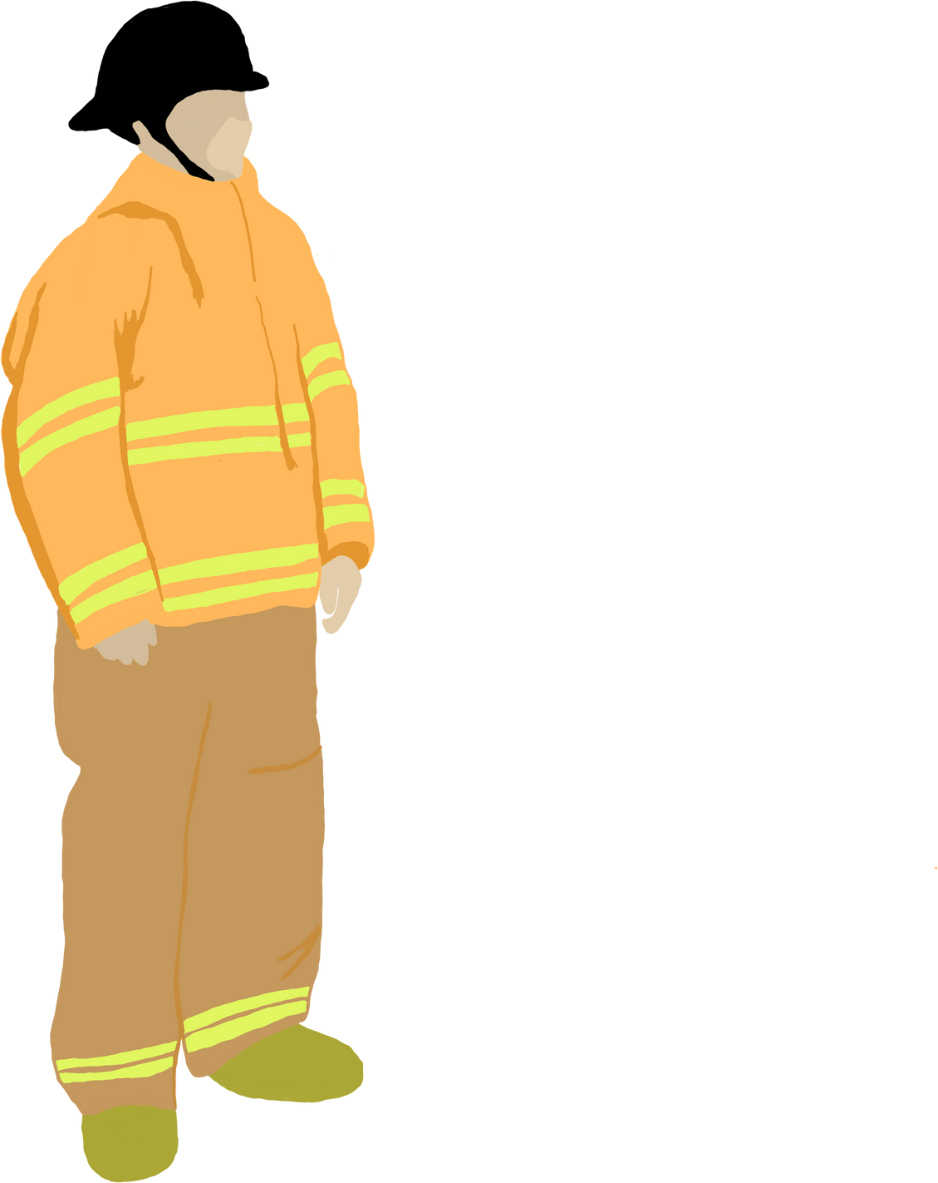








"Empowering Cities: AFR -ARC “Assist-Route Connect " Fusing tech like LoRa and camera analysis. It transforms urban safety. Real-time adjustments, human-tech collaboration, and potential life-saving impact shape a new era. AFR scales to urban needs, echoing wider smart city ambitions.
--- AFR-ARC
TEAM
Tons Of Tech!

Slide 2

OBJECTIVE
To create system for post-accident measures , so as to help reduce casualties related to road accidents

Slide 3


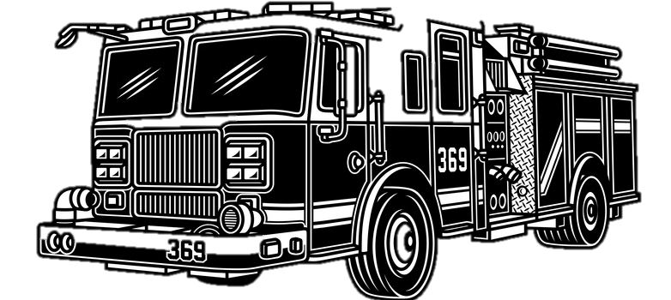



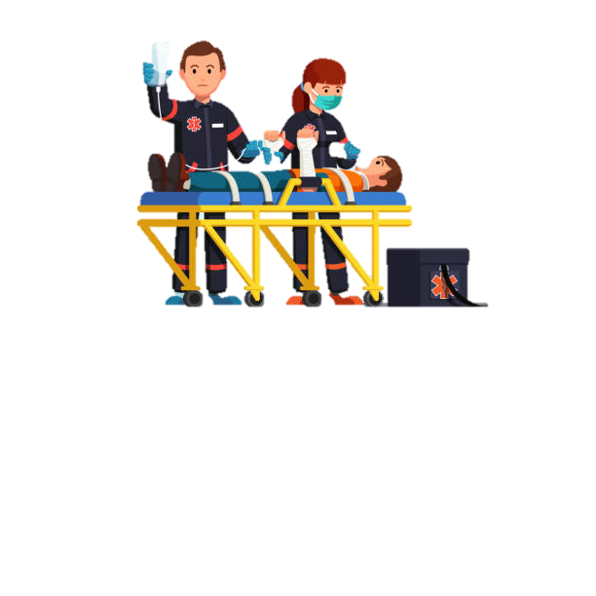

IMPORTANCE OF OUR IDEA!!..
Our project envisions a future where cutting-edge technology empowers emergency vehicles to navigate intersections seamlessly, enhancing public safety and reducing the traffic congestions.
Revolutionize traffic control using LoRa modules, optimizing emergency vehicle response time. Thereby saving the lives and reducing the traffic congestion which promotes public safety

Slide 4
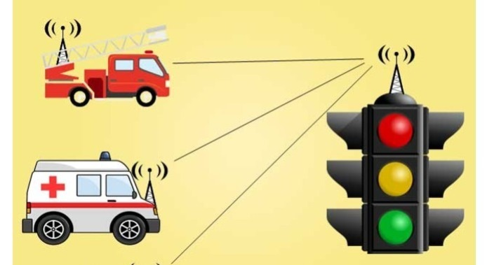

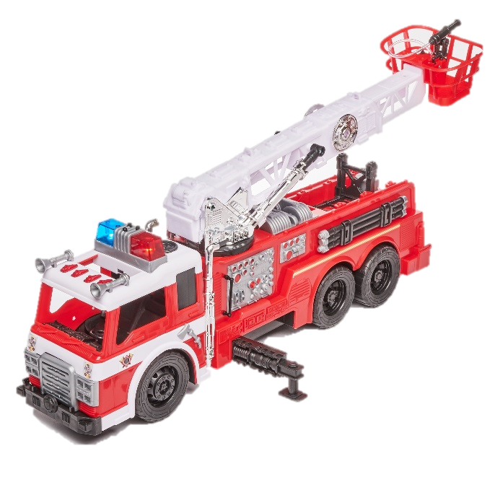
BLOCK DIAGRAM
EMERGENCY VEHICLE DETECTION:
LoRa communication detects approaching emergency vehicle.
TRAFFIC POLICEMAN INTIMATION:
Immediate notification to traffic policeman about incoming emergency vehicle.
MULTIPLE EMERGENCY VEHICLE CHECK:
Verify presence of multiple emergency vehicles on other lanes.
TRAFFIC DENSITY ANALYSIS (ESP-32 CAM MODULE):
ESP-32 camera modules (Den 1 and Den 2) analyze traffic density.
DENSITY COMPARISON:
Compare traffic densities from Den 1 and Den 2.
PRIORITY PASSAGE:
Grant priority passage to other lanes based on density comparison.
DYNAMIC LANE OPENING:
If multiple emergency vehicles detected, open lane with lower density.
TRUE
SINGLE EMERGENCY VEHICLE CASE:
If only one emergency vehicle, open respective lane for free flow.
FALSE

Slide 5
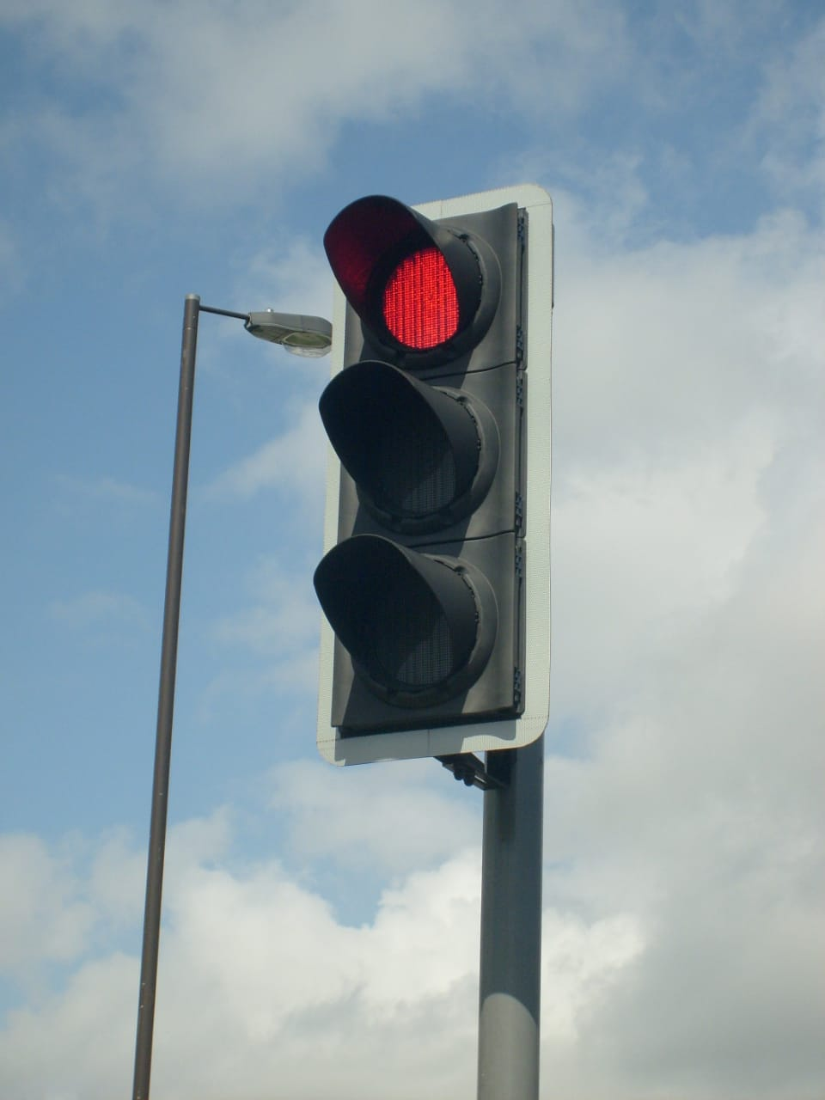

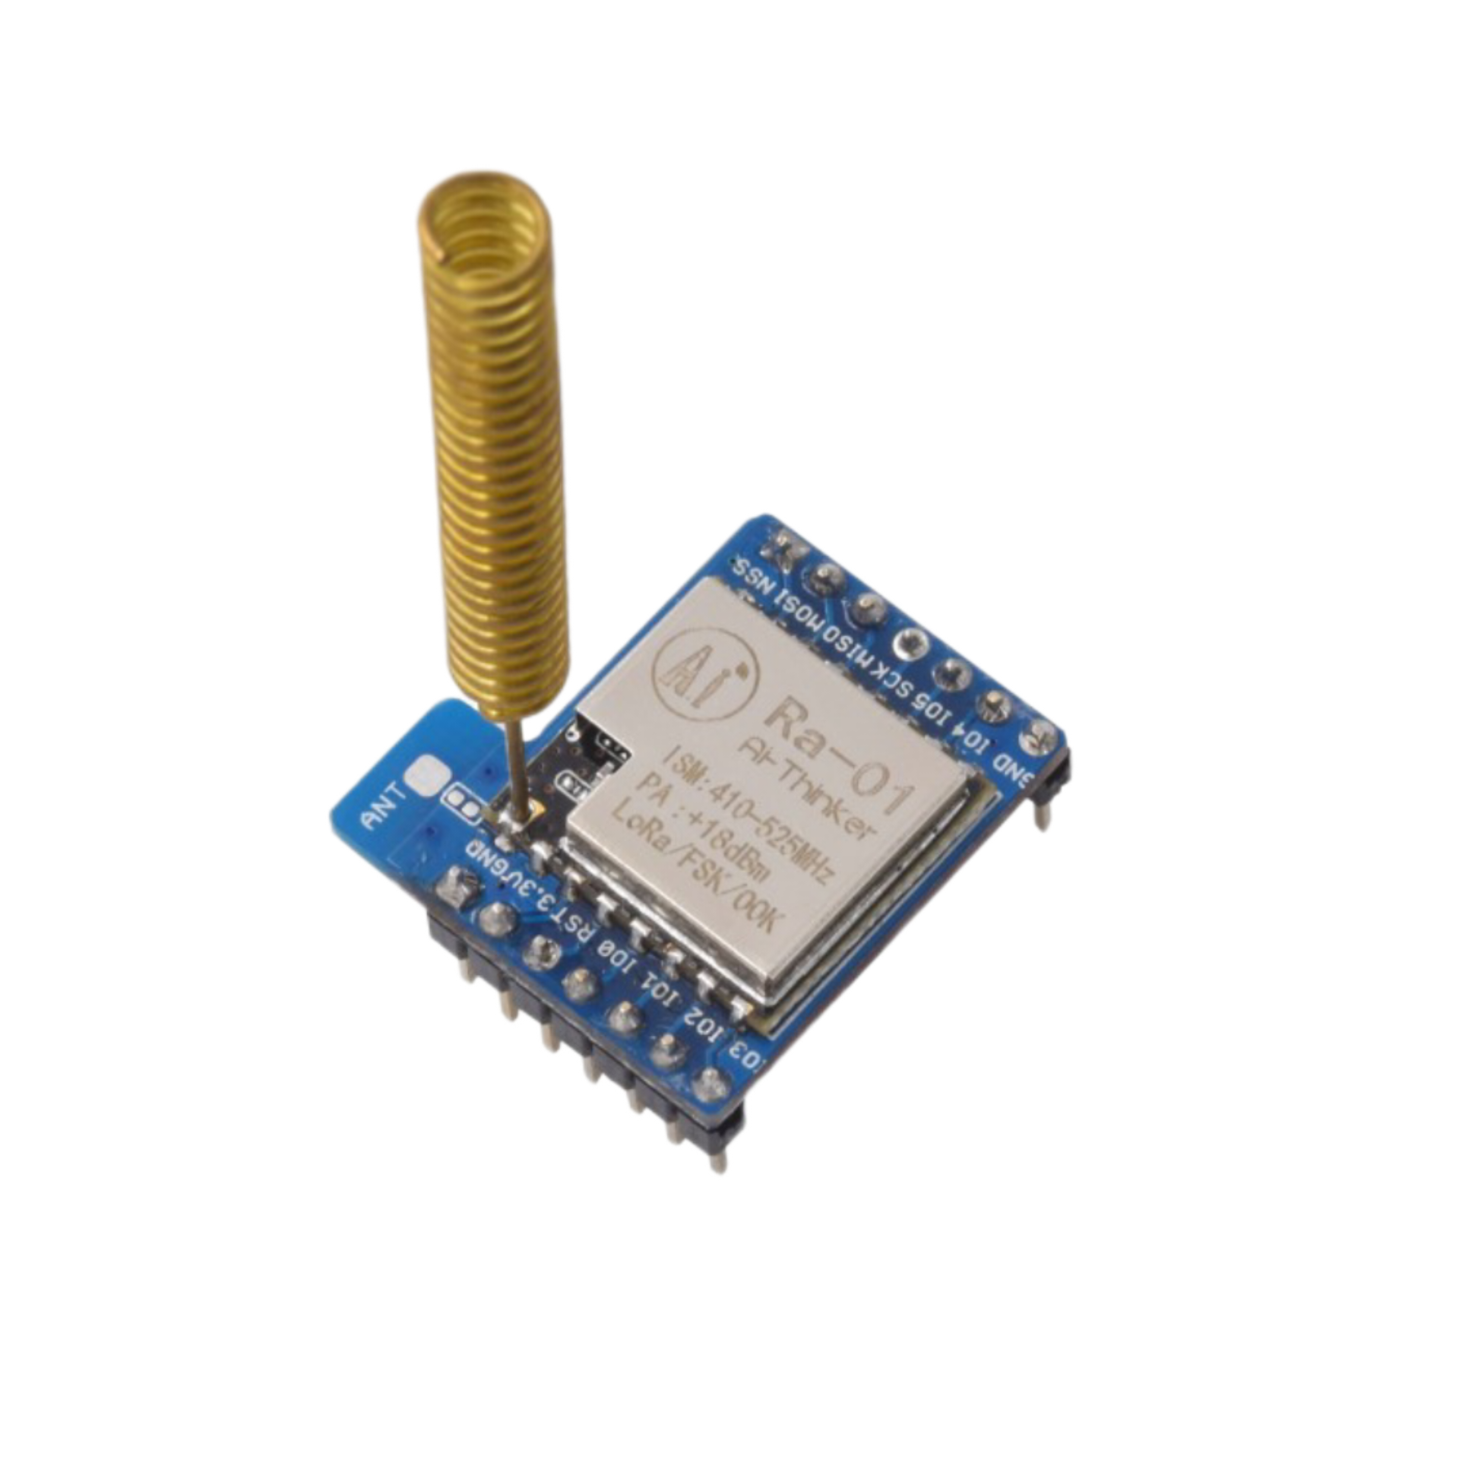
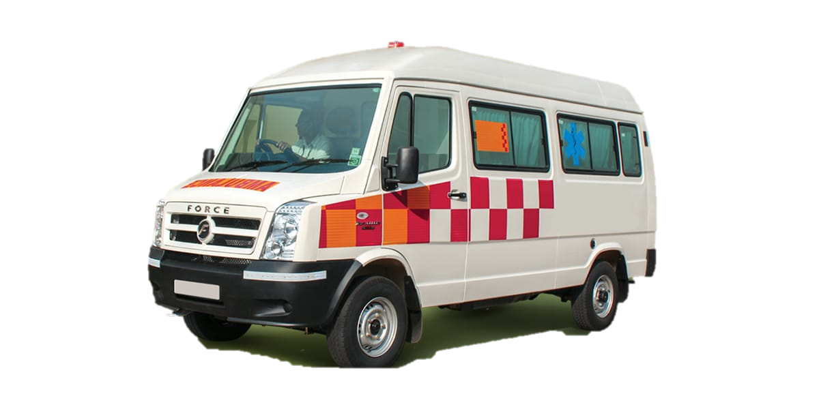
Ambulance arrival & detection by LoRa
Normal functioning of traffic signal
Green signal on detected lane
Ambulance pairing end
Other lanes RED
End-to-End
Pairing
Transmitter
Receiver

Slide 6
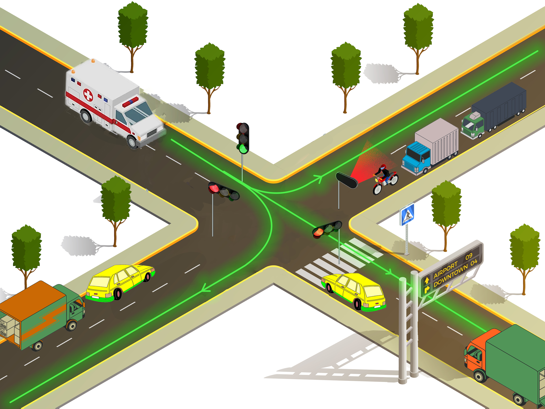
Notes:
SCHEMATIC REPRESENTATION AND {GENERAL DEPICTION}

Slide 7
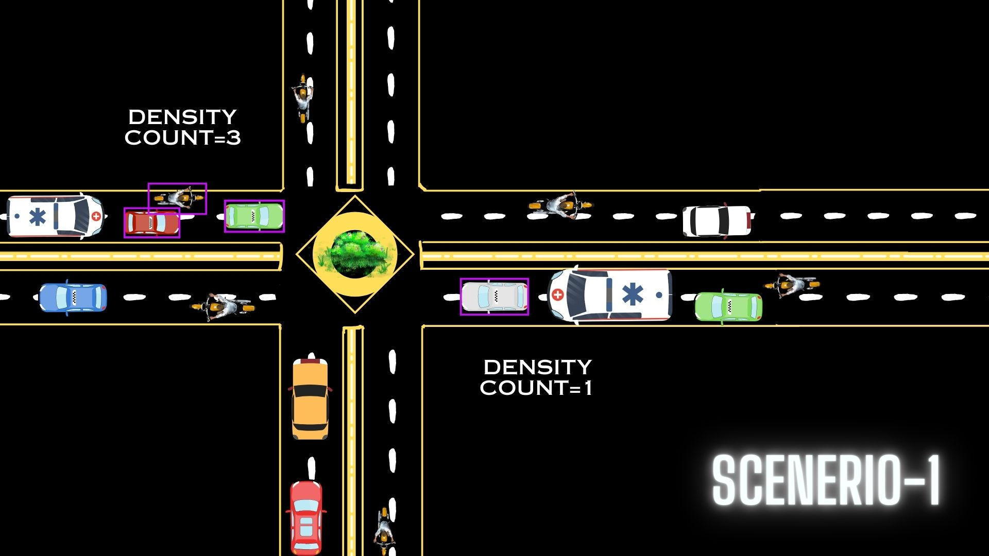
Notes:
SCHEMATIC REPRESENTATION AND {GENERAL DEPICTION}

Slide 8
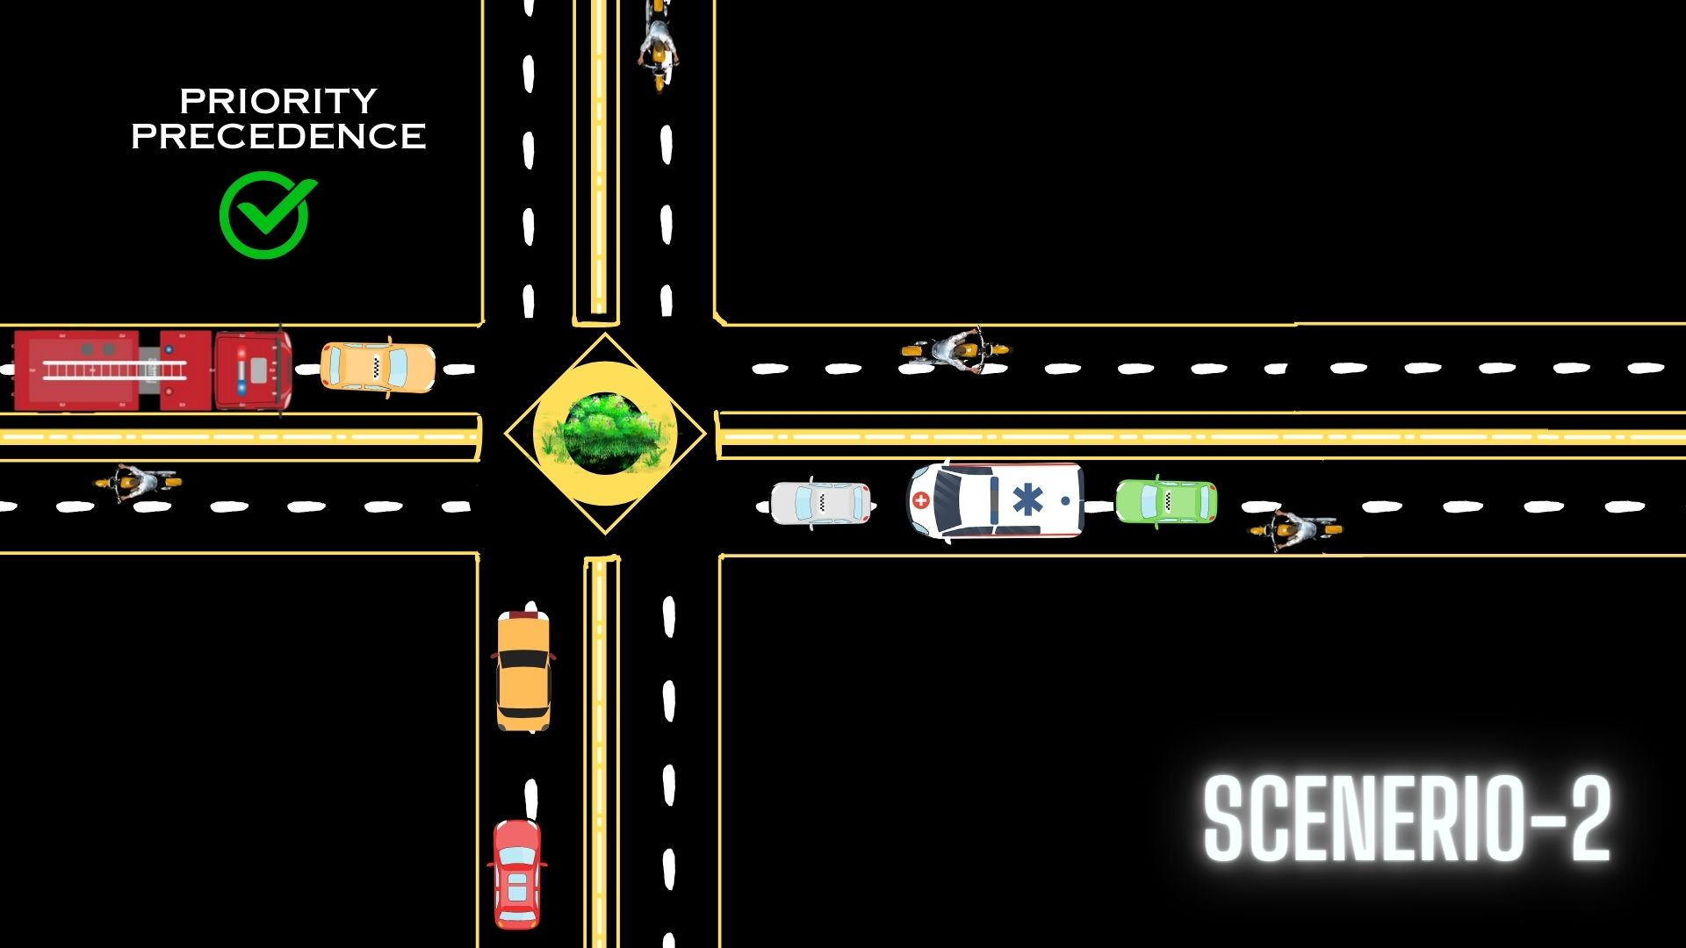
Notes:
SCHEMATIC REPRESENTATION AND {GENERAL DEPICTION}

Slide 9
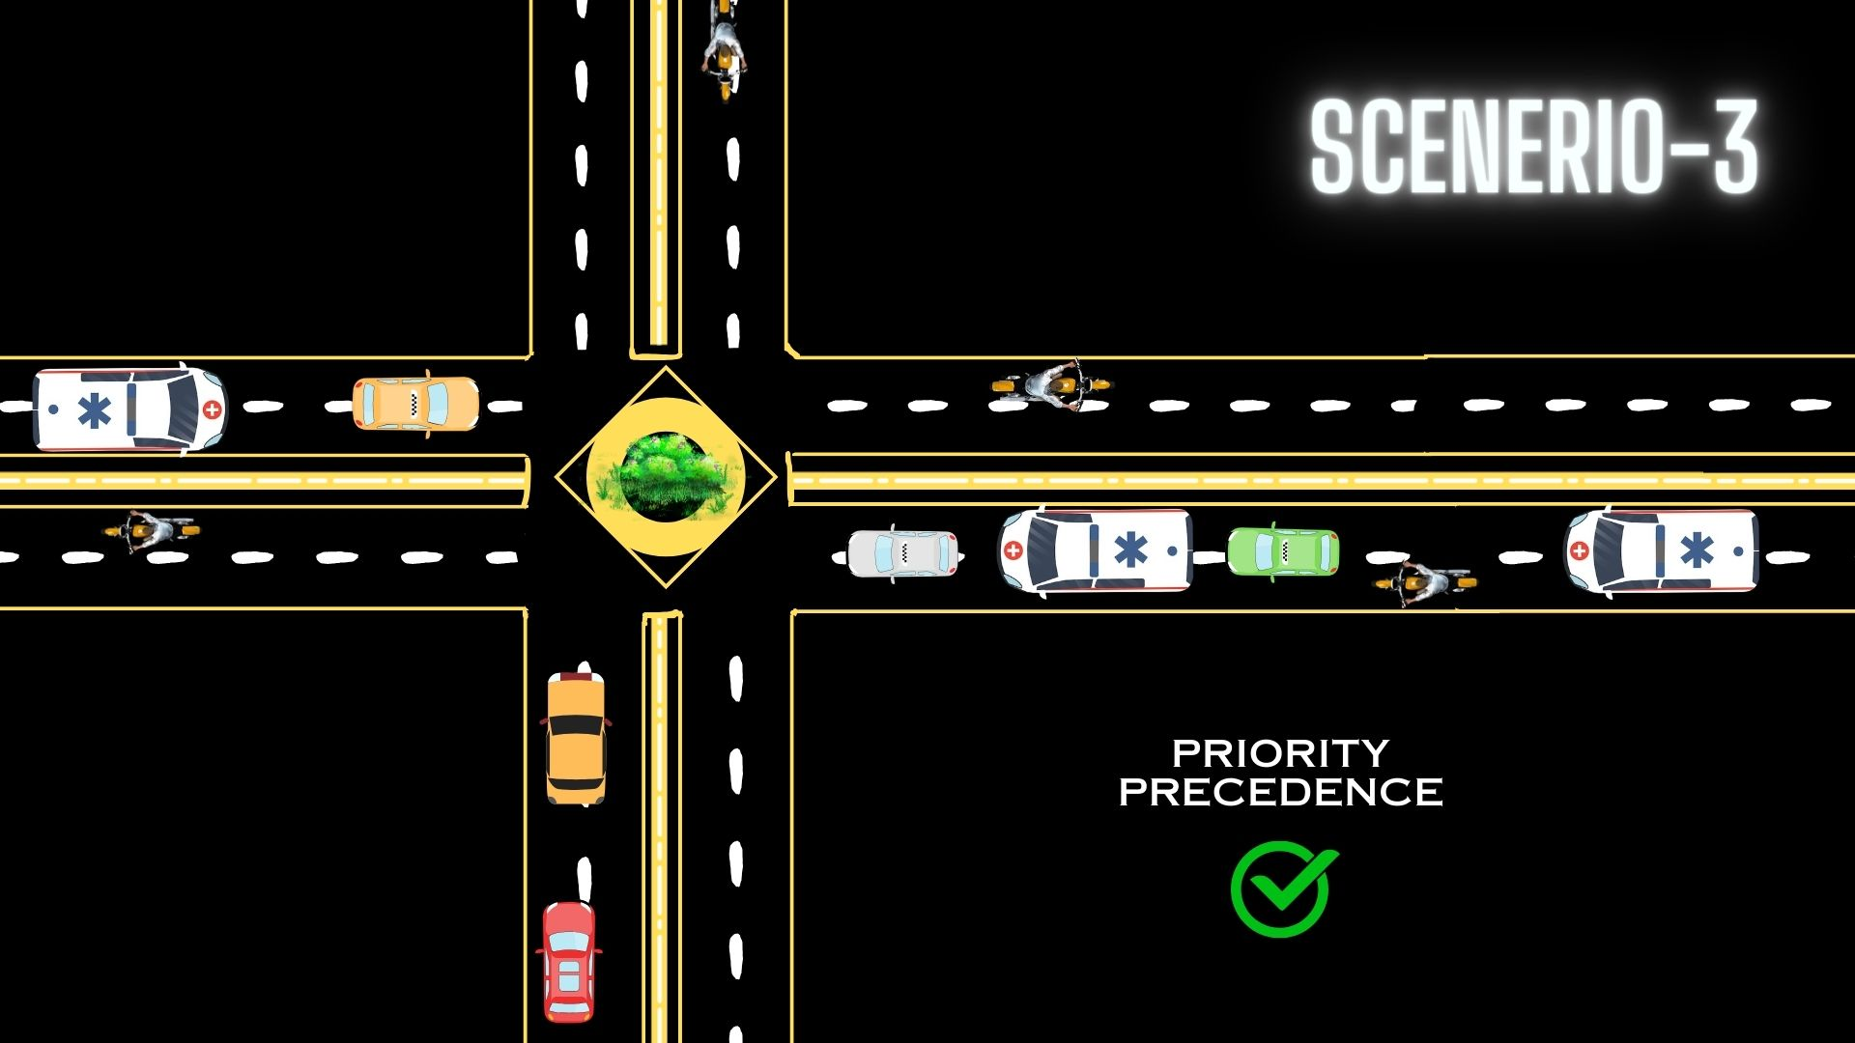
Notes:
SCHEMATIC REPRESENTATION AND {GENERAL DEPICTION}

Slide 10
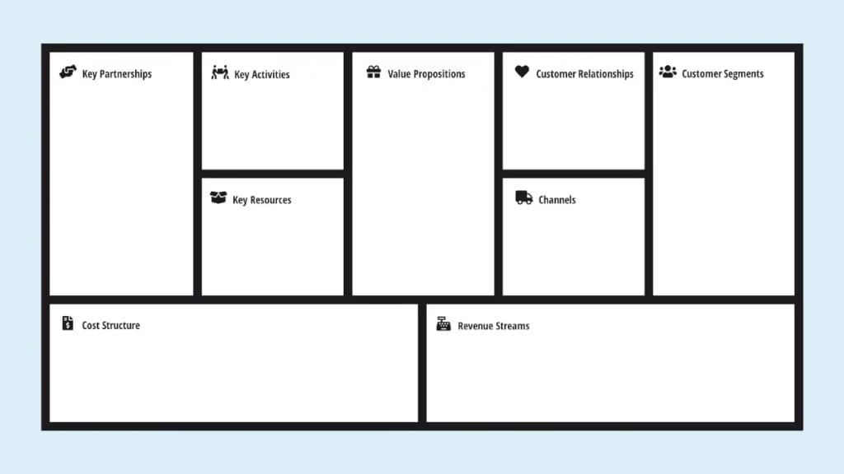
1.Emergency Services: Collaboration for real-time integration.
2.Traffic Authorities: Support for implementation and regulatory approvals.
3.Technology Providers: Suppliers of LoRa modules, cameras, microcontrollers.
1.Technology Development: Design and refine LoRa communication, signal alteration, and routing algorithms.
2.Collaboration: Engage with emergency services and traffic authorities for successful implementation.
1.Enhanced Emergency Response: Swift ambulance passage through synchronized signals.
2.Traffic Flow Optimization: Reduced congestion and improved traffic management
3.Safer Cities: Minimized response times and smoother traffic flow for safer urban environments.
1.Consultative: Working closely with emergency services and traffic authorities to tailor solutions.
2.Support: Continuous technical support and assistance.
1.Emergency Services: Quicker response times and improved patient care.
2.Traffic Authorities: Efficient traffic management and congestion reduction.
3.General Public: Safer roads, reduced congestion, and improved urban mobility.
1.Technology Expertise: Skilled professionals in communication technology, programming, and AI.
2.Infrastructure: Required hardware and software components for AFR implementation.
3.Partnerships: Strong collaboration with emergency services and traffic authorities.
1.Direct Sales: Collaborations with emergency services and traffic authorities.
2.Online Platforms: Educational resources, demos, and updates.
3.Workshops and Seminars: Awareness and knowledge sharing with stakeholders
1.Research and Development: Investment in technology and algorithm development.
2.Hardware and Software: Costs associated with components and licenses.
3.Operational Costs: Maintenance, technical support, and employee salaries.
1.Product Sales: Revenue from selling AFR system and required hardware.
2.Subscription Model: Recurring revenue for maintenance and updates.
3.Consulting Services: Providing implementation and customization services.
(Kindly checkout the BOM of the sample prototype, attached on the following page)

Slide 11

ITEM | QUANTITY | PRICE PER QTY(in rupees) | TOTAL PRICE
ESP 8266 | 1 | 275 | 275
SX1276/78 | 3 | 530 | 1590
Connection wires | 4-5 mtrs | 50 | 50
ESP-32 CAM | 2 | 520 | 1040
Indication box | 2 | 500 | 1000
BMP180 Altitude sensor | 1 | 90 | 90
 |  | TOTAL | 4045
Note: cost estimation provided above is in reference to our prototype model (not the real cases).

